Slide 1
CODING

Slide 2
The coding is the process of transforming the design of a system into a computer
language format.
This coding phase of software development is concerned with software translating
design specification into the source code.
It is necessary to write source code & internal documentation so that conformance of the code to its specification can be easily verified.
Coding is done by the coder or programmers who are independent people than
the designer.
The goal is not to reduce the effort and cost of the coding phase, but to cut to the
cost of a later stage.
The cost of testing and maintenance can be significantly reduced with efficient
coding.

Slide 3
The main advantages of adhering to a standard style of coding are as follows:
A coding standard gives uniform appearances to the code written by different engineers
It facilitates code of understanding.
Promotes good programming practices.

Slide 4
Goals of Coding
To translate the design of system into a computer language format: The coding is the process of transforming the design of a system into a computer language format, which can be executed by a computer and that perform tasks as specified by the design of operation during the design phase.
To reduce the cost of later phases: The cost of testing and maintenance can be significantly reduced with efficient coding.
Making the program more readable: Program should be easy to read and understand. It increases code understanding having readability and understandability as a clear objective of the coding activity can itself help in producing more maintainable software.

Slide 5
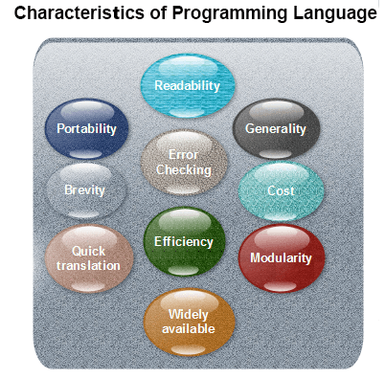
For implementing the design phase into coding phase, the programmer required a
high-level functional programming language.
A programming language should have the following characteristics:

Slide 6
Characteristics of a Good Programming Language
Readability: A good high-level language will allow programs to be written in some ways that resemble a quite-English description of the underlying algorithms. If care is taken, the coding may be done in a way that is essentially self-documenting.
Portability: High-level languages, being essentially machine independent, should be able to develop portable software.
Generality: Most high-level languages allow the writing of a wide variety of programs, thus relieving the programmer of the need to become expert in many diverse languages.
Brevity: Language should have the ability to implement the algorithm with less amount of code. Programs expressed in high-level languages are often considerably shorter than their low-level equivalents.
Error checking: Being human, a programmer is likely to make many mistakes in the development of a computer program. Many high-level languages enforce a great deal of error checking both at compile-time and at run-time.

Slide 7
Cost: The ultimate cost of a programming language is a function of many of its characteristics.
Familiar notation: A language should have familiar notation, so it can be understood by most of the programmers.
Quick translation: It should admit quick translation.
Efficiency: It should permit the generation of efficient object code.
Modularity: It is desirable that programs can be developed in the language as a collection of separately compiled modules, with appropriate mechanisms for ensuring self-consistency between these modules.
Widely available: Language should be widely available and it should be possible to provide translators for all the major machines and for all the major operating systems.

Slide 8
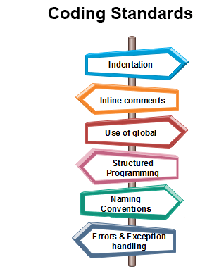
Coding Standards
General coding standards refers to how the developer writes code, so here we will
discuss some essential standards regardless of the programming language being
used.
The following are some representative coding standards:

Slide 9
Indentation: Proper and consistent indentation is essential in producing easy to read and maintainable programs. Indentation should be used to:
Emphasize the body of a control structure such as a loop or a select statement.
Emphasize the body of a conditional statement
Emphasize a new scope block
Inline comments: Inline comments analyze the functioning of the subroutine, or key aspects of the algorithm shall be frequently used.
Contents of the headers preceding codes for different modules: The information contained in the headers of different modules should be standard for an organization.
The exact format in which the header information is organized in the header can also be specified.
The following are some standard header data: • Name of the module. • Date on which the module was created. • Author’s name. • Modification history. • Synopsis of the module. • Different functions supported, along with their input/output parameters. • Global variables accessed/modified by the module.
Notes:
*Spaghetti Style: Structured Style:
1 i = 0 1 FOR i = 1 TO 100
i = i + 1 2 PRINT i ; “ squared = ”; i * i
PRINT i ; “ squared = ” ; i * I 3 NEXT i
IF i >= 100 THEN GOTO 6 4 PRINT “ Example of Structured Style Programming. ”
GOTO 2 5 END
PRINT “ Example of Spaghetti Style
Programming .”
7 END

Slide 10
Rules for limiting the use of global: These rules file what types of data can be declared global and what cannot.
Structured Programming: Structured (or Modular) Programming methods shall be used.
"GOTO" statements shall not be used as they lead to "spaghetti" *code, which is hard to read and maintain, except as outlined line in the FORTRAN Standards and Guidelines.
Naming conventions for global variables, local variables, and constant identifiers: A possible naming convention can be that global variable names always begin with a capital letter, local variable names are made of small letters, and constant names are always capital letters.
Error return conventions and exception handling system: Different functions in a program report the way error conditions are handled should be standard within an organization.
For example,
different tasks while encountering an error condition should either return a
0 or 1 consistently.

Slide 11
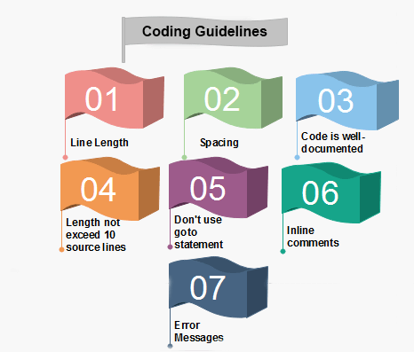
Coding Guidelines
General coding guidelines provide the programmer with a set of the best methods which can be used to make programs more comfortable to read and maintain. Most of the examples use the C language syntax, but the guidelines can be tested to all languages.
The following are some representative coding guidelines recommended by many software development organizations.

Slide 12
The length of any function should not exceed 10 source lines: A function that is very lengthy is usually very difficult to understand as it probably carries out many different functions.
For the same reason, lengthy functions are likely to have disproportionately larger number of bugs.
Spacing: The appropriate use of spaces within a line of code can improve
readability.
Example: (without proper syntax)
Bad: cost=price+(price*sales_tax) fprintf(stdout ,"The total cost is %5.2f\n“, cost);
Better: cost = price + ( price * sales_tax ) fprintf (stdout, "The total cost is %5.2f\n“, cost);
The code should be well-documented: As a rule of thumb, there must be at least one comment line on the average for every three-source line.
Do not use GOTO statements: Use of GOTO statements makes a program unstructured and very tough to understand.

Slide 13
Do not use a coding style that is too clever or too difficult to understand: Code should be easy to understand.
Many inexperienced engineers actually take pride in writing cryptic and incomprehensible code.
Clever coding can obscure meaning of the code and hamper understanding. It also makes maintenance difficult.
Line Length: It is considered a good practice to keep the length of source code lines at or below 80 characters.
Lines longer than this may not be visible properly on some terminals and tools. Some printers will truncate lines longer than 80 columns.
Inline Comments: Inline comments promote readability.
Error Messages: Error handling is an essential aspect of computer programming. This does not only include adding the necessary logic to test for and handle errors but also involves making error messages meaningful.

Slide 14
Do not use an identifier for multiple purposes:
Programmers often use the same identifier to denote several temporary entities.
Each variable should be given a descriptive name indicating its purpose.
This is not possible if an identifier is used for multiple purposes.
Use of a variable for multiple purposes can lead to confusion and make it difficult for somebody trying to read and understand the code.
Use of variables for multiple purposes usually makes future enhancements more difficult.

Slide 15
Code Review
Code review for a model is carried out after the module is successfully compiled and the all the syntax errors have been eliminated.
Code reviews are extremely cost-effective strategies for reduction in coding errors and to produce high quality code.
Normally, two types of reviews are carried out on the code of a module.
These two types code review techniques are code inspection and code walk through.

Slide 16
Code Walk Through
Code walk through is an informal code analysis technique.
In this technique, after a module has been coded, successfully compiled and all
syntax errors eliminated.
The main objectives of the walk through are to discover the algorithmic and logical errors in the code.
Even though a code walk through is an informal analysis technique, several
guidelines have evolved over the years for making this naïve but useful analysis
technique more effective.
Some of these guidelines are the following:
The team performing code walk through should not be either too big or too small.
Ideally, it should consist of between three to seven members.
Discussion should focus on discovery of errors and not on how to fix the discovered errors.
In order to foster cooperation and to avoid the feeling among engineers that they are
being evaluated in the code walk through meeting, managers should not attend the
walk through meetings.

Slide 17
Code Inspection
The aim of code inspection is to discover some common types of errors caused due
to oversight and improper programming.
Following is a list of some classical programming errors which can be checked
during code inspection:
Use of uninitialized variables.
Jumps into loops.
Non-terminating loops.
Incompatible assignments.
Array indices out of bounds.
Improper storage allocation and deallocation.
Mismatches between actual and formal parameter in procedure calls.
Use of incorrect logical operators or incorrect precedence among operators.
Improper modification of loop variables.
Comparison of equally of floating point variables, etc.

